Slide 1
Sub Routines – Void Functions (Procedures)

Slide 2
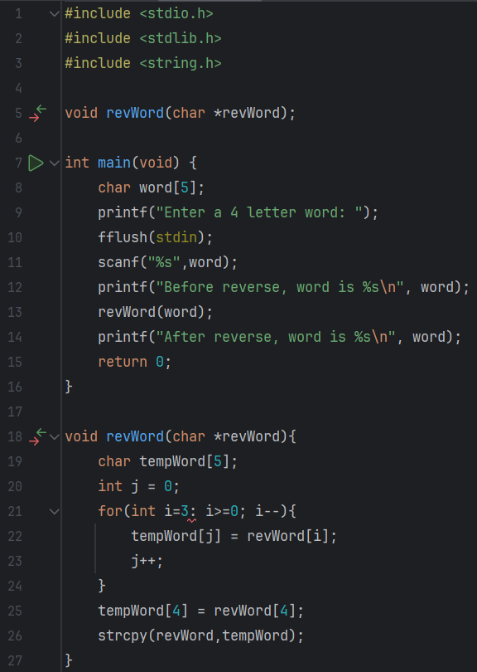
Predict
What do you think this code does?
It asks the user for a 4 letter word. It then prints out the word before it was reversed. It passes the word as a parameter to the function revWord, which works out what the word is backwards amnd outputs it to the user in the main program.

Slide 3
Run
What does the code do?
It asks the user for a 4 letter word. It then prints out the word before it was reversed. It passes the word as a parameter to the function revWord, which works out what the word is backwards amnd outputs it to the user in the main program.
Does this match your prediction?
Yes.
Download the code from Github and run it!

Slide 4
Investigate
Investigation Activities
What are the name of the variables being used?word, i What data types do they hold? integers What are the names of the functions? revWord and main What type of data do these return? integer Why is there an asterisk in line 18? Because it is an array Why does line 8 specify five characters but line 9 tell the user to only enter 4?because computers start counting from 0 Annotate lines 4-26 to explain what each line of code does.

Slide 5
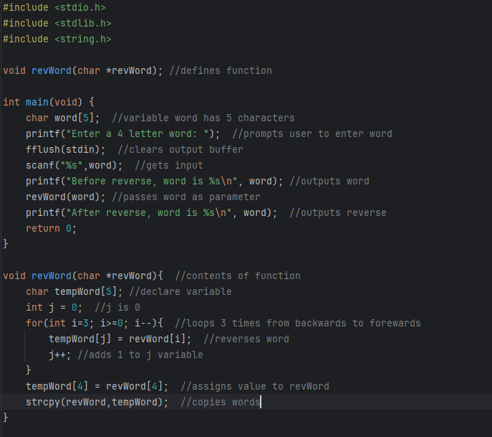

Slide 6
Modify
Modification Activities
Modify the code to accept 10 letter words.

Slide 7
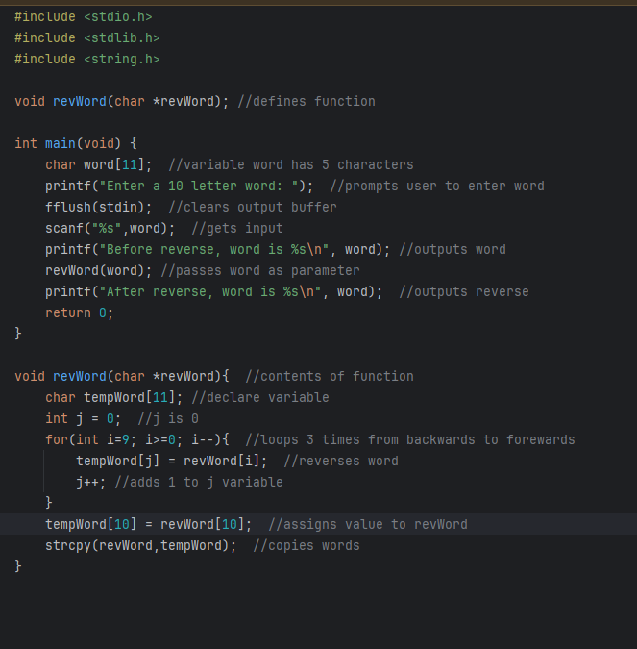

Slide 8
Make
Make Activities
Write a program that will store 5 test scores, then edit the score list to blank out any scores that are 20 or less. Requirements: In the main() function: Ask the user to input 5 scores and store these into an array The score should be between 0 and 75 Print out the list of scores BEFORE you call your function Pass a pointer to the scores array into a function named editScores() Print the list of scores again to show the updated data In editScores(): Use a loop to edit the data in the scores array so that any score of 20 or lower is set to 0

Slide 9
